Slide 1
Calculator in c++
Presented by hassan Farooq ahmad and toseef Iqbal butt

Slide 2
Control structures
Control structure is a process in which control the flow of execution in the program. Basic structures are given below:
Sequence
Conditional statements
Reptative structure

Slide 3
Arrays
An array is a group of consecutive memory location with same number and type.
Each element in the array is accessed with reference to its position of location in the array.
This position is called index.
Array index start from zero.
Declaration: DataType Name[ ] = {Data};

Slide 4
Functions
A function is a named blocked of code that performed some action. A statement written in a function are executed when it is called by its name.
Types of functions
1) user define function
2) build in function

Slide 5
Our project
In this project, we use control structures, arrays, and functions to make a special calculator in C++ with these functions which calculates:
Addition, Substraction, Multliplication, Division.
Angles(Sine, Cosine, Tangent).
log of Number
Square & Square Root
Factorial of Number

Slide 6
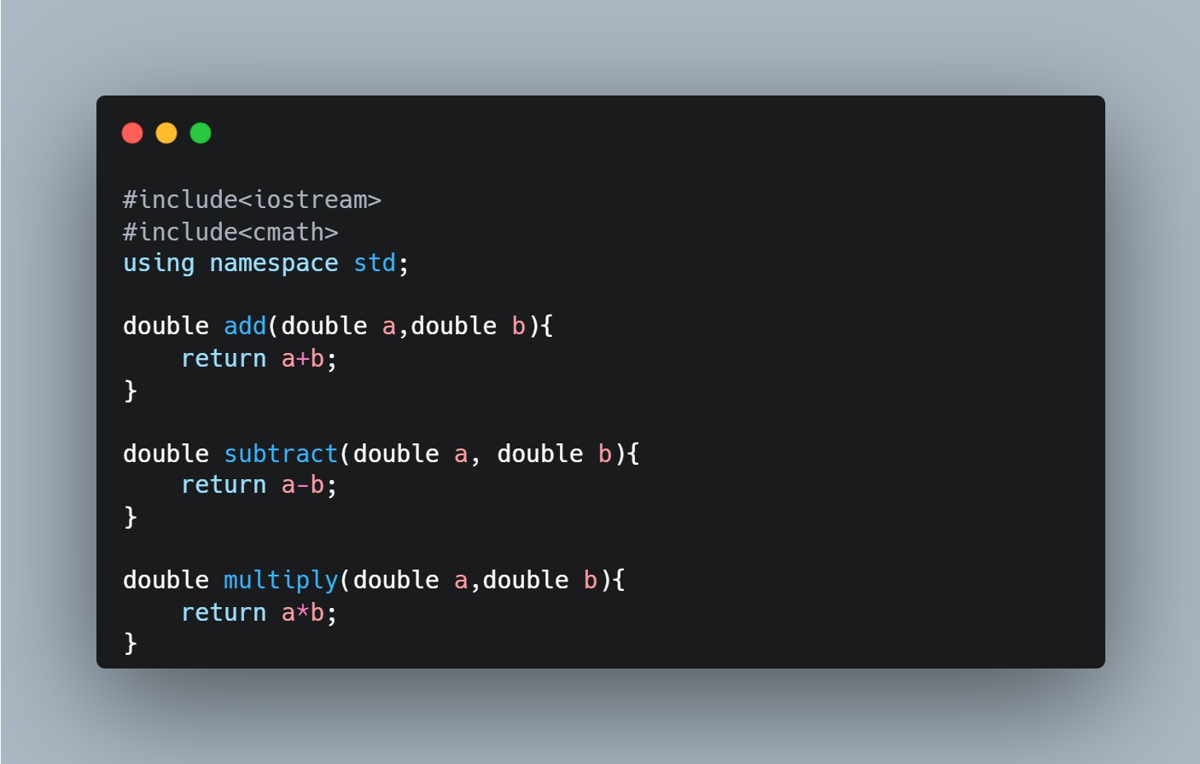

Slide 7
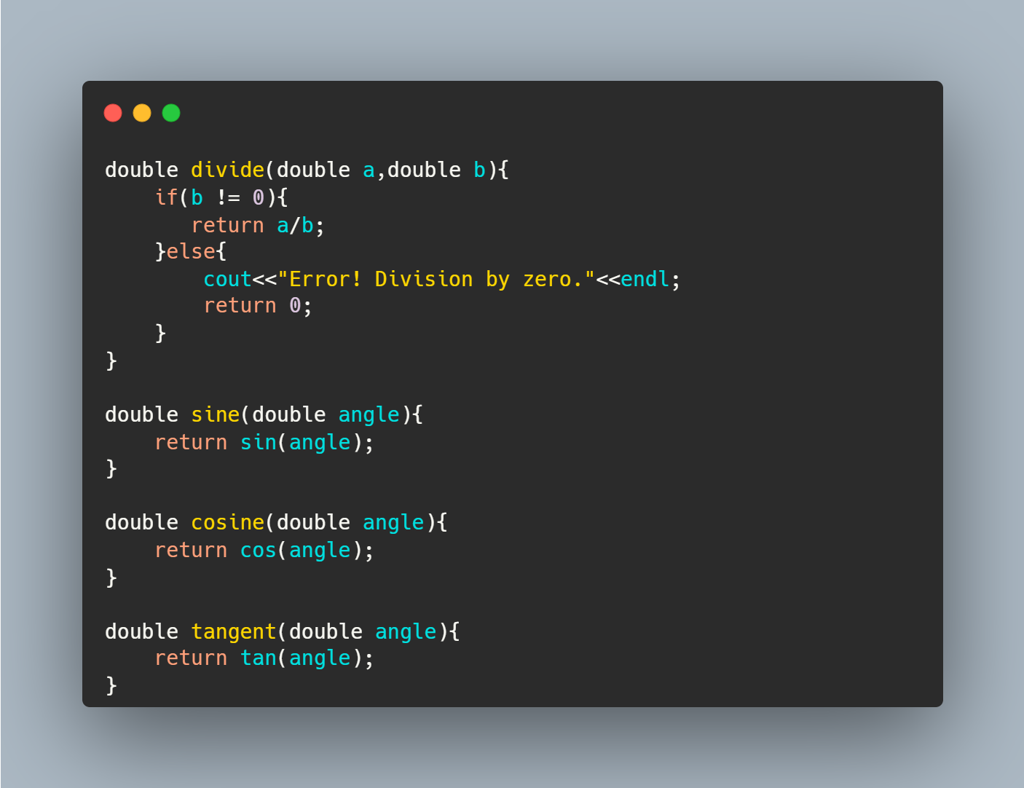

Slide 8
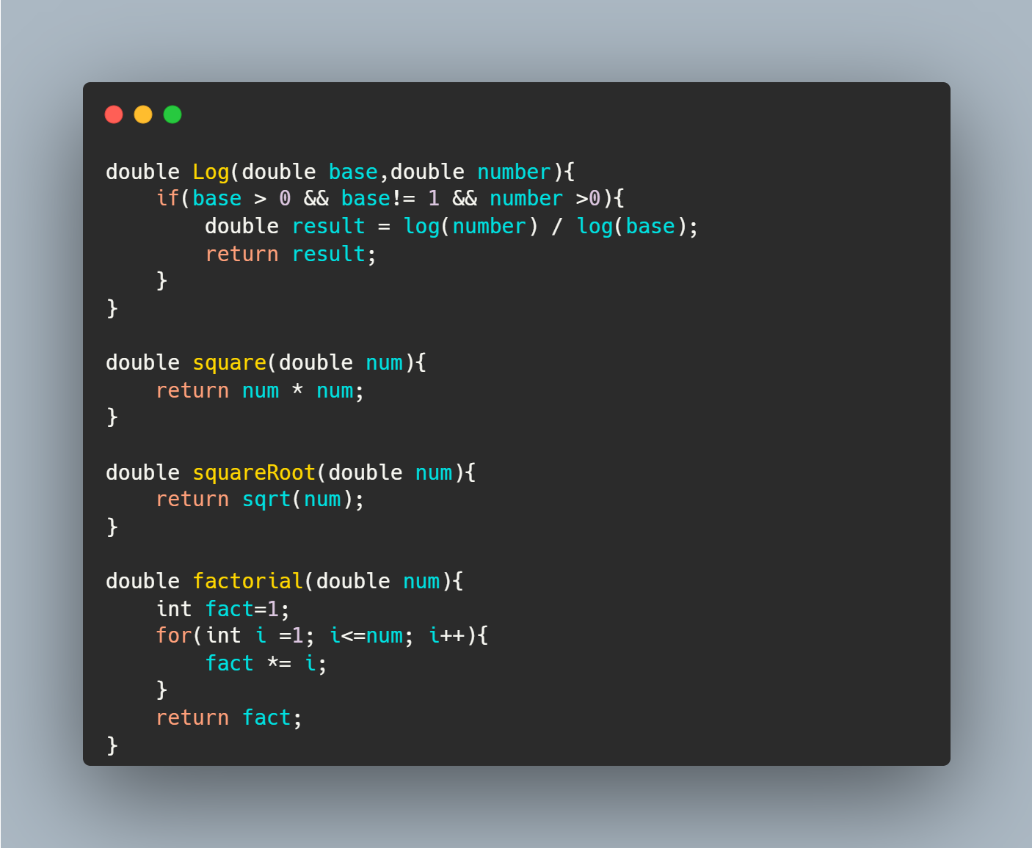

Slide 9
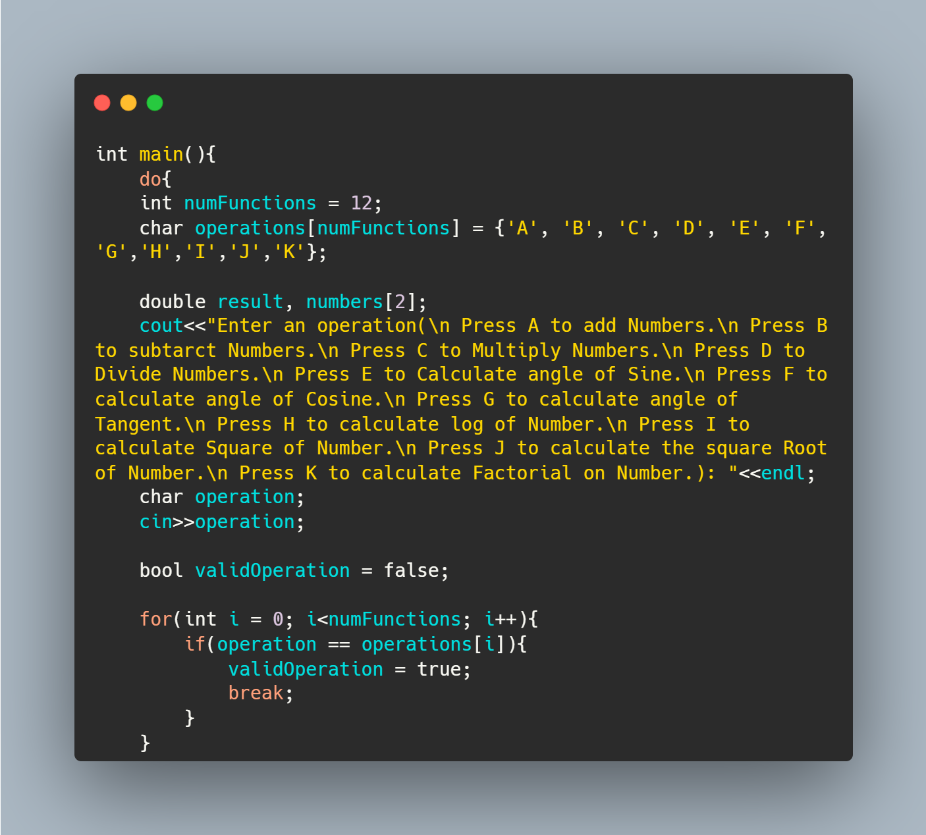

Slide 10
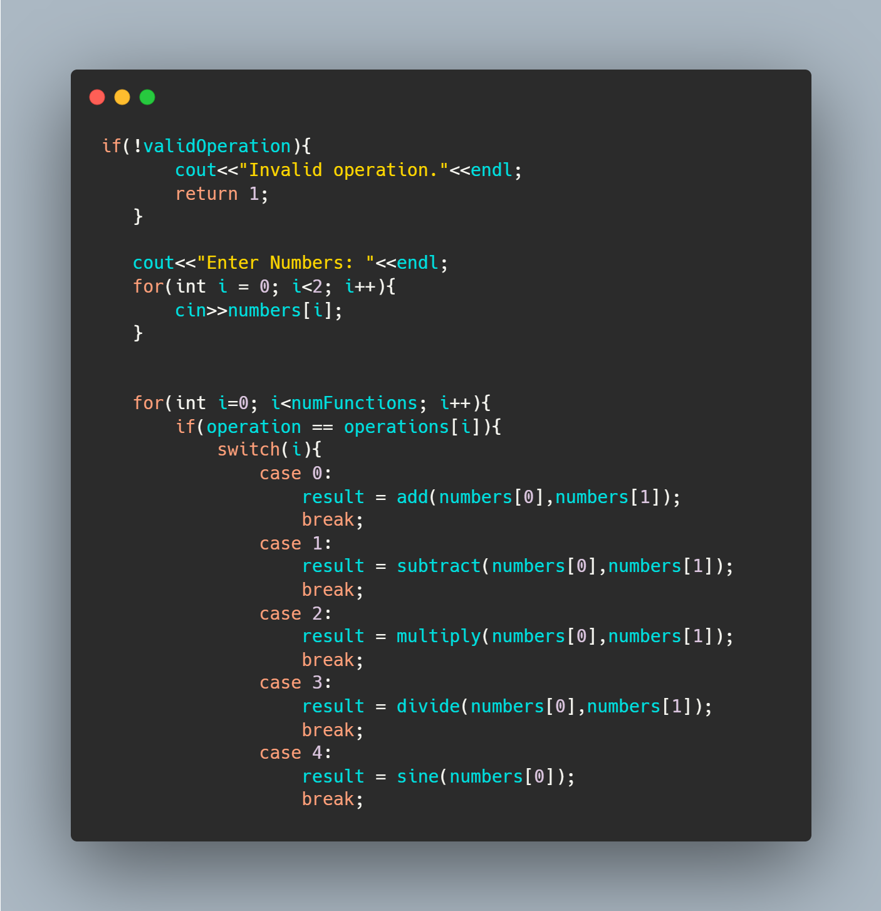

Slide 11
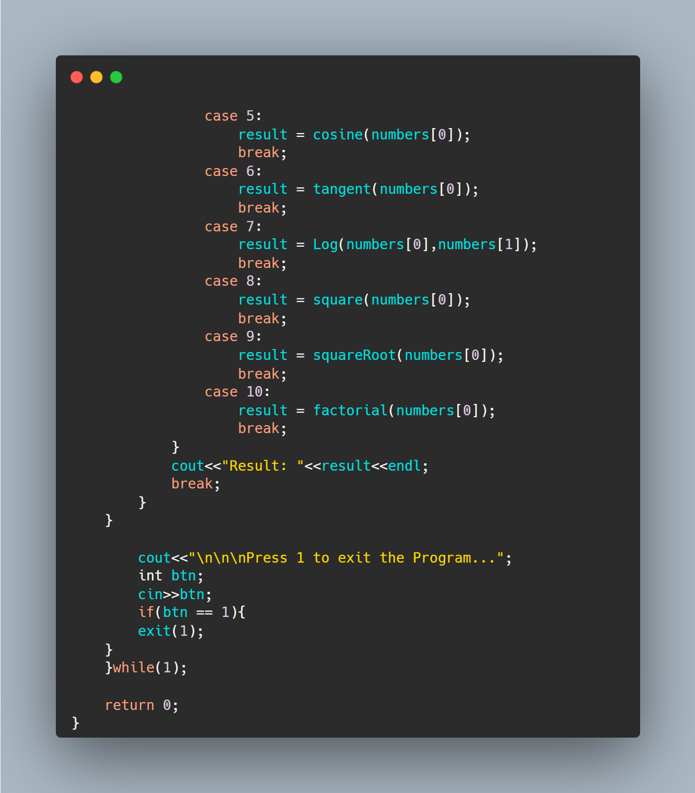

Slide 12
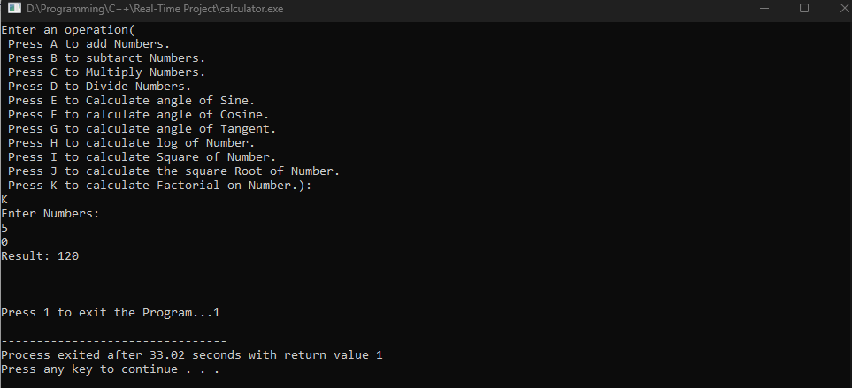

Slide 13
File of Code…………..

Slide 14
JazakAllah
.

